Slide 1

Smart Contracts Audit
Notes:
The roots of blockchain technology lies in DLT. A ledger is a collection of records basically, which grows as more records keeps on adding. The concept of DLT means to replicate and distribute the records/ledger with multiple parties to avoid tampering of record once it is put on the ledger. The main reason DLT was invented was to avoid tampering of data once generated. So whatever we talk about after this minute, will have a primary goal, to stop manipulation of data once generated and stored in a ledger. Now blockchain is a type of DLT. Blockchain is a collection of list of records in form of blocks where each blocks are connected with eachother through cryptography. This makes a chain of blocks and it keeps on growing as new records keep on adding to the ledger.

Slide 2
What is Smart Contract ?
A Smart contract is just a simple code that runs on top of a blockchain containing set of rules under which the stakeholders agree to interact with each other.
Smart Contracts are self executing and self verifying.
Notes:
Being a DLT, the blockchain is also distributed throughout all affiliated parties.
Now Blockchain makes sure that once the data is put on ledger, it cannot be manipulated. But what if the data that is put is itself manipulated.
Thats when smart contract comes into picture.
Self executing, self verifying
Backbone of blockchain

Slide 3
Sample Smart Contract Code
pragma solidity 0.4.0; contract SimpleStorage { uint storedData; function set(uint x) public { storedData = x; } function get() public view returns (uint) { return storedData; } }
Notes:
Define version of solidity ( this is 4th version. Latest is 0.5 )
Contract name (
Define variable ( unsigned integer - positive values only ) ( we can even define it’s size. Uint 256,8 etc )
Set function ( gas is charged ) ( right now set function has public visibility. We have 4 types of visibilities - public, private, external, internal )
Get function ( no gas is charged ) ( 2 types of getter functions - view ( only to view ) and pure ( edits doesnot affect global variables, only local variables).

Slide 4
Issues with Smart Contracts ( Ethereum )
Ownership (Parity attack (30 mil Usd) and Oyester pearl attack)
Reentrancy (The famous Dao attack 50 mil Usd)
Underflow and Overflow
Short Address attack (Golem Attack)
External Calls — Every external contract call is a risk(make sure all the internal work(state condition) is complete before calling external functions)
Storage injection vulnerability in NEO Smart Contracts (which allows anyone to change the token’s total supply limit by transferring their own tokens to an unspecified address.)
Notes:
Ownership - lag in ownership transfer ( hackers use selfdestruct function to take over contract ) ( solution - no delay ni authorizing )
Reentrance - 100rs , 10 rs ( solution - avoid state change after external call )
To overcome underflow, we use safemath libraries
Short address attack - address is of 20 bytes. Leading and trailing zeros. There is address and value. When trailing zero is missing, it will use value as trailing zero. Thus making value nill ( negative ), which means less than zero, thus unit will become 2^256. ( solution - only payload size )

Slide 5
Ownership Attack
150,000 ETH (~30M USD)
This causes all public functions from the library to be callable by anyone, including initWallet, which can change the contract’s owners. Unfortunately, initWallet has no checks to prevent an attacker from calling it after the contract was initialized. The attacker exploited this and simply changed the contract’s m_owners state variable to a list containing only their address, and requiring just one confirmation to execute any transaction:
Notes:
A function named initialised wallet had no ownership. Hackers attacked it before ownership was transferred to real owner.
Solution - we should have defined authentication of function, who can call it

Slide 6
Reentrancy
function() public {
dao.withdraw(dao.assignedCredit(this));
}
function withdraw(uint amount)
{
if (credit[msg.sender] >= amount) {
msg.sender.call.value(amount)();
credit[msg.sender] -= amount;
}
Notes:
State update -
Fallback function

Slide 7
Underflow and Overflow
First things first, let’s make sure we understand what an uint256 is. A uint256 is an unsigned integer of 256 bits (unsigned, as in only positive integers). The Ethereum Virtual Machine was designed to use 256 bits as its word size, or the number of bits processed by a computer’s CPU in one go. Because EVM is limited to 256 bits in size, the assigned number range is 0 to 4,294,967,295 (2²⁵⁶). If we go over this range, the figure is reset to the bottom of the range (2²⁵⁶ + 1 = 0). If we go under this range, the figure is reset to the top end of the range (0–1= 2²⁵⁶).
Notes:
Solution - safemath library use karna ( if mere paas 100 token hai, mujhe dene hai 10. Maine -10 likh diya, toh atleast 100 hi approve ho, balance se zyada nahi. Jisse future me tokens aaye to woh transfer na ho jaaye )

Slide 8
External Calls
External Calls — Every external contract call is a risk, make sure all the internal work (state condition) is complete before calling external functions or contracts .
All the transfer calls should be made after completing internal work first.
Notes:
Internal states update ho jaaye uske baad external call karni chahiiye

Slide 9
Issues with Smart Contracts ( EOS )
Buffer overflows
Proper memory management
dangling pointers
Permissions to action mapping
Optimising RAM usage

Slide 10
Buffer overflows
Maliciously Exploitable
Hotspots : Array size, Numerical flow

Slide 11
Proper memory management
- Check overflows of RAM values
- prevent loss of data
Notes:
People exploit prices of RAM by holding it and generating fake demand

Slide 12
Dangling pointers
- Pointers pointing to stray locations
- Locations can be maliciously targeted
Notes:
Pointer - memory ko reference dena ( pointing that my variable is stored here )
Pointers defined but not used

Slide 13
Permissions to action mapping
- Cause of many hacks of EOS Dapps
- Check for actions to permission mapping
- Hotspots: Transfer receipts and actions
Notes:
Define actions - kon kis function ko call kar sakta hai

Slide 14
Optimising RAM usage
- Critical and costly resource
- Know when to buy and release RAM
- Know when to allocate and deallocate RAM storage

Slide 15
Why is Security Audit necessary
To catch the bugs that humans missed.
To reduce known attacks on your Smart Contract.
To ensure all paths of functions are functioning as intended to be.
Notes:
Developers are unable to implement exact business use case in ICO, STO, Dapp, etc
Thus to identify security issues and fundamental issues
Auditors are sane hackers.

Slide 16
Importance of Security Audit
Marketing
( Secure contract attract more investors and users )
Security
Validate Use-Case

Slide 17

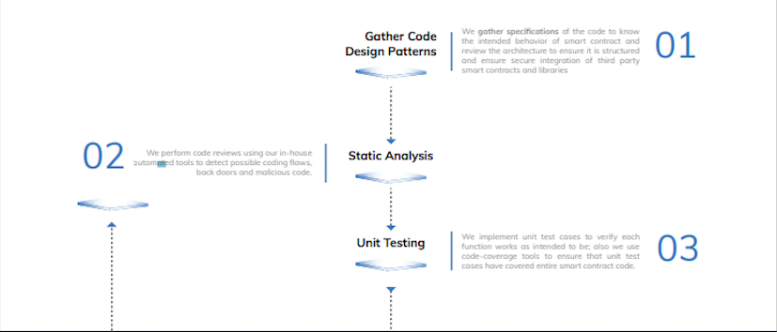
An Ideal Audit Process

Slide 18
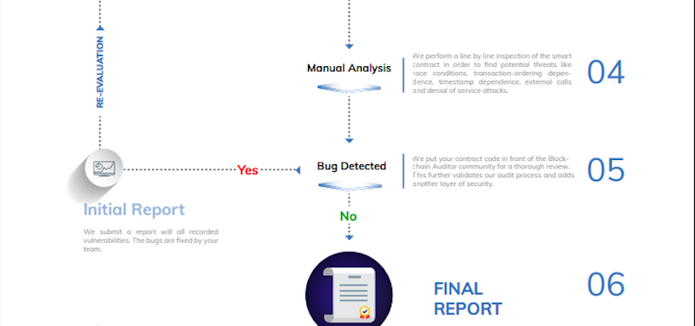
Notes:
Manual analysis - on testnet

Slide 19
Types of Tools
Security Tools (Mythril, Oyente, Slither)
Testing Tools (Truffle)
Monitoring Tools (Quill-SDK, Neufund~ to monitor transaction )
Notes:
Security tools are to check known attacks
Testing tools are frameworks to do unit testing
oyente , mythril both works on runtime

Slide 20
Mythril Classic
Mythril Classic is an open-source security analysis tool for Ethereum smart contracts. It uses concolic analysis, taint analysis and control flow checking to detect a variety of security vulnerabilities.
Notes:
2 types of tools - static, runtime.

Slide 21
Features of Mythril
Concolic analysis : Symbolic Analysis, treating variable as a symbol to generate new concrete inputs(test suits), aim of maximizing code coverage.
Taint analysis : The taint analysis is a popular method which consists to check which variables can be modified by the user input.
Control flow checking : To check order in which statements, instruction and function calls taking place.

Slide 22
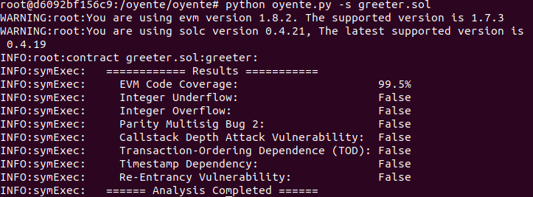
Oyente
Oyente is able to detect some of the latest security flaws of Ethereum, including TheDAO bug, which caused a loss of 50 million US dollars in June 2016.

Slide 23
Oyente Features
Attacks checked by Oyente :
Timestamp dependence attack
Reentrancy bug
Concurrency bug
Overflow/Underflow

Slide 24
Slither Tool
Slither is a Solidity static analysis framework written in Python 3. It runs a suite of vulnerability detectors, prints visual information about contract details, and provides an API to easily write custom analyses. Slither enables developers to find vulnerabilities, enhance their code comprehension, and quickly prototype custom analyses.
Notes:
Slither is static tool

Slide 25
Slither Features
Attacks check by Slither
Suicidal (self destructing)
uninitialized-state
External-function call
reentrancy

Slide 26
Output by Slither Tool
+-----------------+------------+-----------+----------------+-------+---------------------------+----------------+
| Function | Visibility | Modifiers | Read | Write | Internal Calls | External Calls |
+-----------------+------------+-----------+----------------+-------+---------------------------+----------------+
| i_am_a_backdoor | public | [] | ['msg.sender'] | [] | ['selfdestruct(address)'] | [] |
+-----------------+------------+-----------+----------------+-------+---------------------------+------------

Slide 27
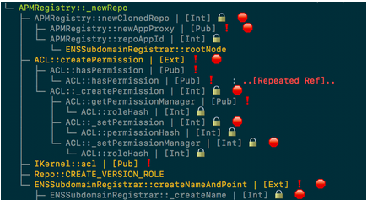
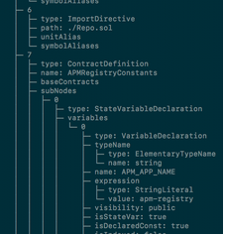
Sūrya Tools
It provides a number of visual outputs and information about the contracts' structure. Also supports querying the function call graph in multiple ways to aid in the manual inspection of contracts.

Slide 28
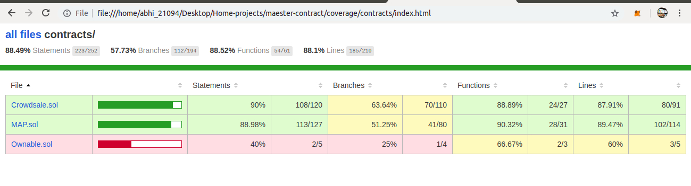
Solidity-coverage
This tool identify how efficient Unit testing were, or how much code is covered in unit testing, This step is important because it is required to know whether unit tests touch each line of code or not to minimise the vulnerability of code.

Slide 29
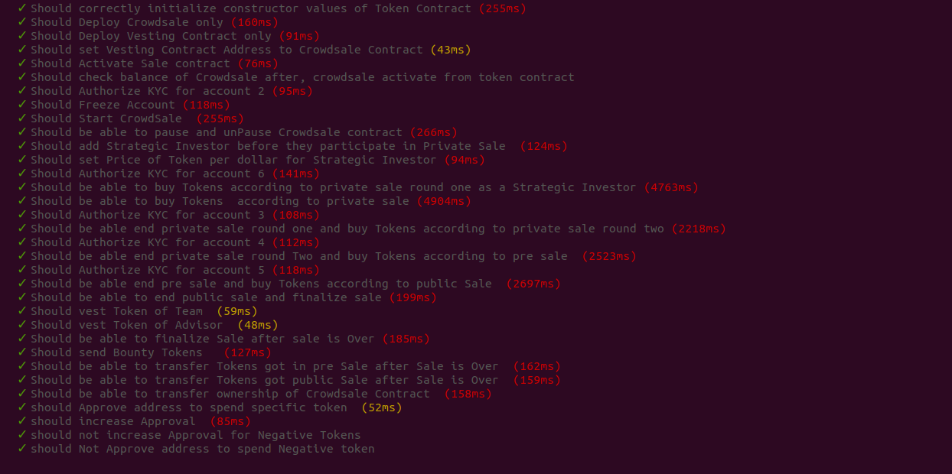
Unit Test Cases by QuillAudits

Slide 30


